Slide 1
What is a mathemusician?
James Austin Myer (The CUNY Graduate Center)
2024 Math League International Summer Tournament
The College of New Jersey

Slide 2
Musical Notation is a Graph of Frequency over Time
La menu dégustation:
Brahms, Piano Quartet in C minor, opus 60, 4th mvt., Finale (2:16-3:51)
Bach, Fugue in A Minor, organ (BWV 543) (1:06-2:06)
Bach, Double Violin Concerto, 1st mvt. “Vivace” BWV 1043 (0:00-0:47)
Bach, “Crab Canon” (on a Möbius strip)
Notes:
Excerpt from Serge Koussevitzky’s Double Bass Concerto, mvt. II
Question for poster:
“Does anyone know the name of (point to tenor clef)?”

Slide 3
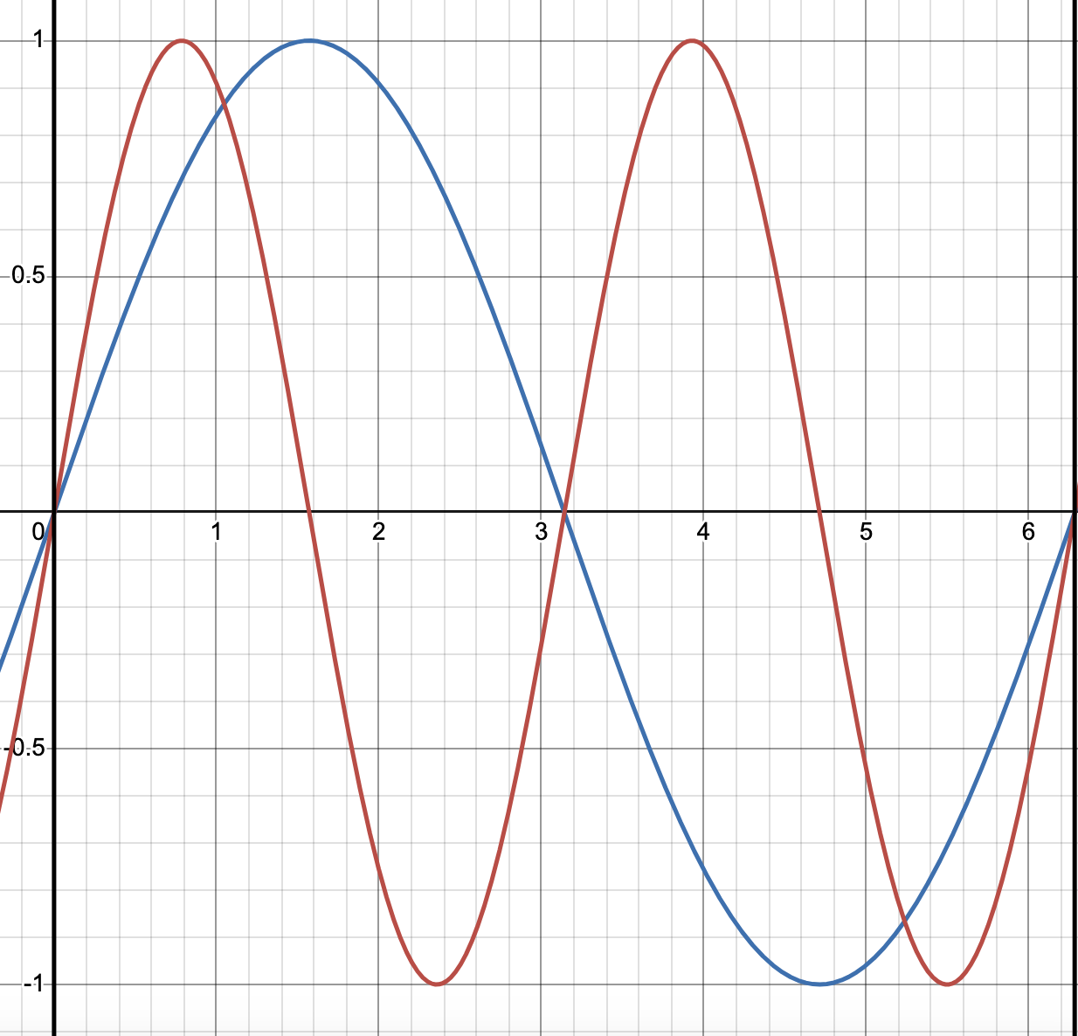
Harmony is Frequency in Ratio
2:1 = octave
3:2 = fifth
4:3 = fourth
5:4 = (major) third
5:3 = (major) sixth (versus Pythagorean (major) sixth = 27:16)
9:8 = (major) second
81:64 = “ditone”
243:128 = (Pythagorean (major) seventh)
“Close is enough”
Let’s see ‘em: Visualize Frequency in Ratio
& hear ‘em: Listen to Frequency in Ratio
(and on instruments!)
Notes:
Play intervals on bass/guitar to illustrate
Bass tuned to:
G2 = 97.999 Hz
D2 = 73.416 Hz
A1 = 55 Hz
E1 = 41.203 Hz
Guitar tuned to:
E4 = 329.63 Hz
B3 = 246.94 Hz
G3 = 196.00 Hz
D3 = 146.83 Hz
A2 = 110.00 Hz
E2 = 82.41 Hz

Slide 4
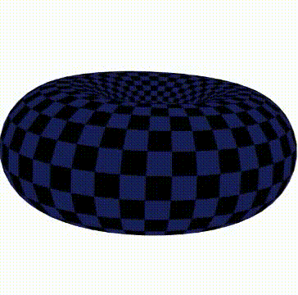
Pleasant Voice Leading is Geodesic Motion I
Chord Geometries à la Dmitri Tymoczko
Notes:
Play a bit on bass/guitar to illustrate pleasant voice leading

Slide 5
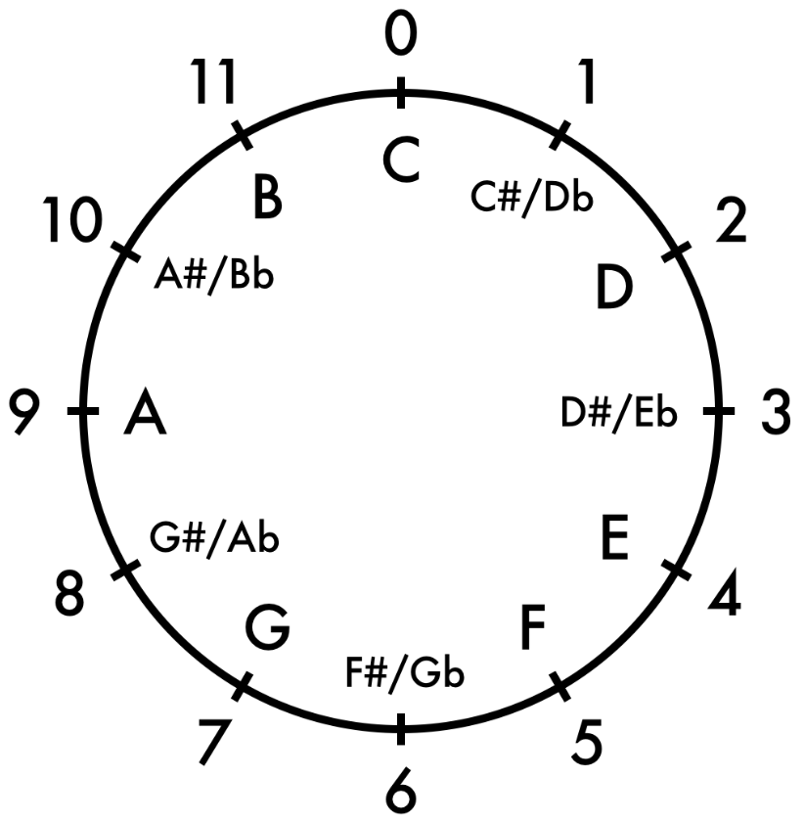
Chromaticism is Arithmetic Modulo 12
… Let’s hear it!
Notes:
Play the chromatic scale on bass/guitar to illustrate:
(on bass) C2 = 0, C#2 = 1, …, B2 = 11, C3 = 0, …
(on guitar) C3 = 0, etc.
Discuss “addition” of pitch classes, e.g. B “+” F := 11 + 5 = 11 + (1 + 4) = (11 + 1) + 4 = 12 + 4 = 0 + 4 (modulo 12) = 4 = E, i.e. B “+” F = E. This idea is important for jirafaGraph…
If nobody managed to answer “Does anyone know the name of (point to tenor clef)?” to earn the poster, then ask:
“Can someone tell me what A + B is?”

Slide 6
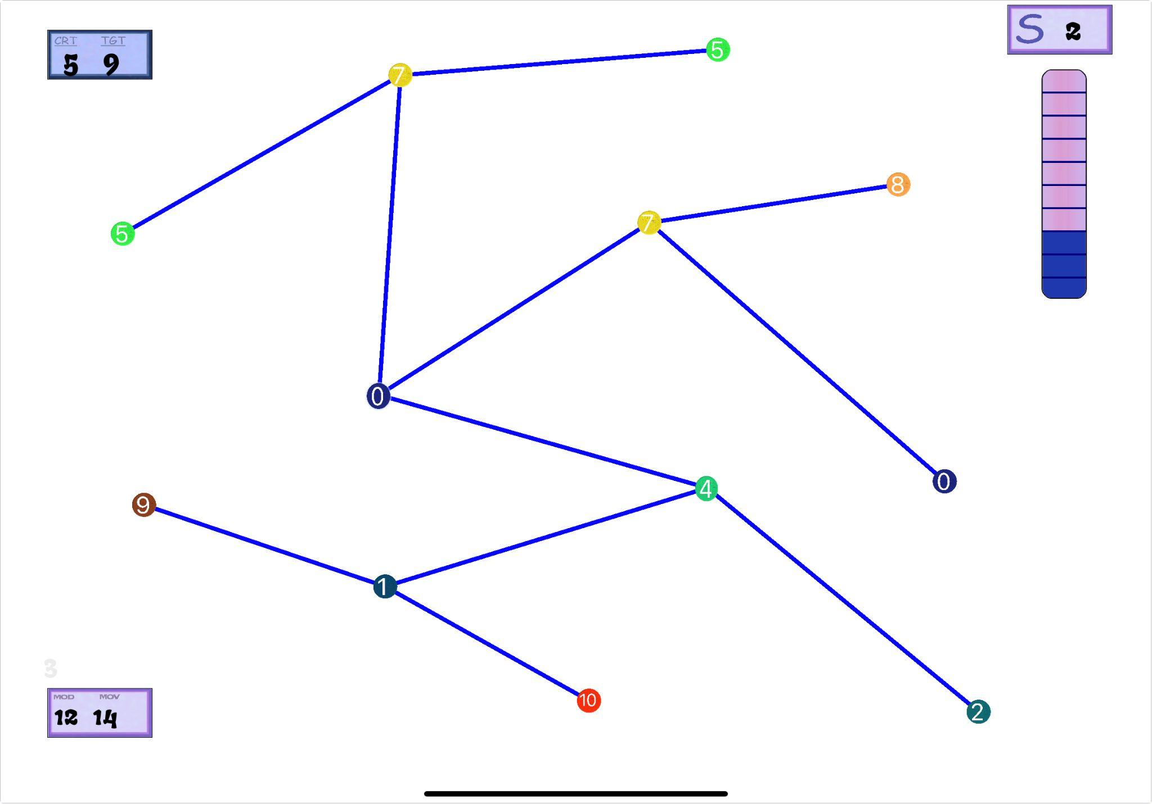
A Mathemusical Game/App:
jirafaGraph
jirafaGraph
Let’s play!
Notes:
Demonstrate via iPad, and, after progressing a bit, ask an audience member:
“Can you manage to reach the target value in 5 steps?”
Do this twice. Each winner gets a T-shirt.
Then encourage audience to download the app themselves. Allow them to play for a few minutes.

Slide 7
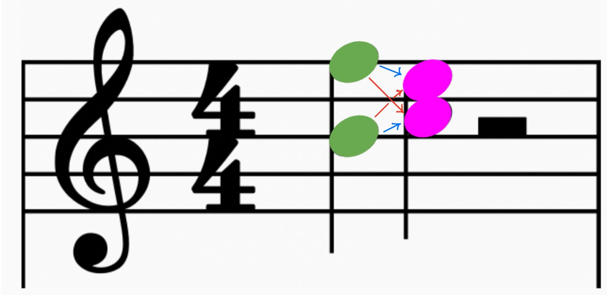
Pleasant Voice Leading is Geodesic Motion II
Let’s listen!
Notes:
P:=\{5,11\}
\alpha:=\{(5, 4), (11, 0)\}
\beta:=\{(5, 0), (11, 4)\}
\text{displacement}(\alpha):=\{\{1, 1\}\}\text{ (multiset)}
Alpha & beta are voice leadings from the (multi)set of pitches (truly, pitch classes) {5, 11} → {0, 4}, and alpha is more efficient than beta because its displacement (multi)set is smaller:
Alpha < beta iff there exists a real number d satisfying:
For any real number c, if c < d, then c appears the same number of times in the displacement multisets of alpha & beta, AND
d appears fewer times in the displacement multiset of alpha than that of beta, e.g.
{{3, 2, 1}} < {{3 + epsilon}} with witness d = 3 + epsilon; the first clause is vacuously satisfied: no real number c appears in both displacement multisets, and 3 + epsilon = d appears 0 times in the leftmost multiset, but once in the second.
{{4, 3}} < {{4, 3, 3}} with witness d = 3; the first clause is vacuously satisfied: no real number c < 3 = d appears at all, and 3 = d appears once in the leftmost multiset, but twice in the second.
So, {{1, 1}} < {{5, 5}} with witness d = 5; the first clause is, again, vacuously satisfied (as in the first of the above e.g.’s), and 5 = d appears 0 times in the leftmost multiset, but twice in the rightmost.

Slide 8
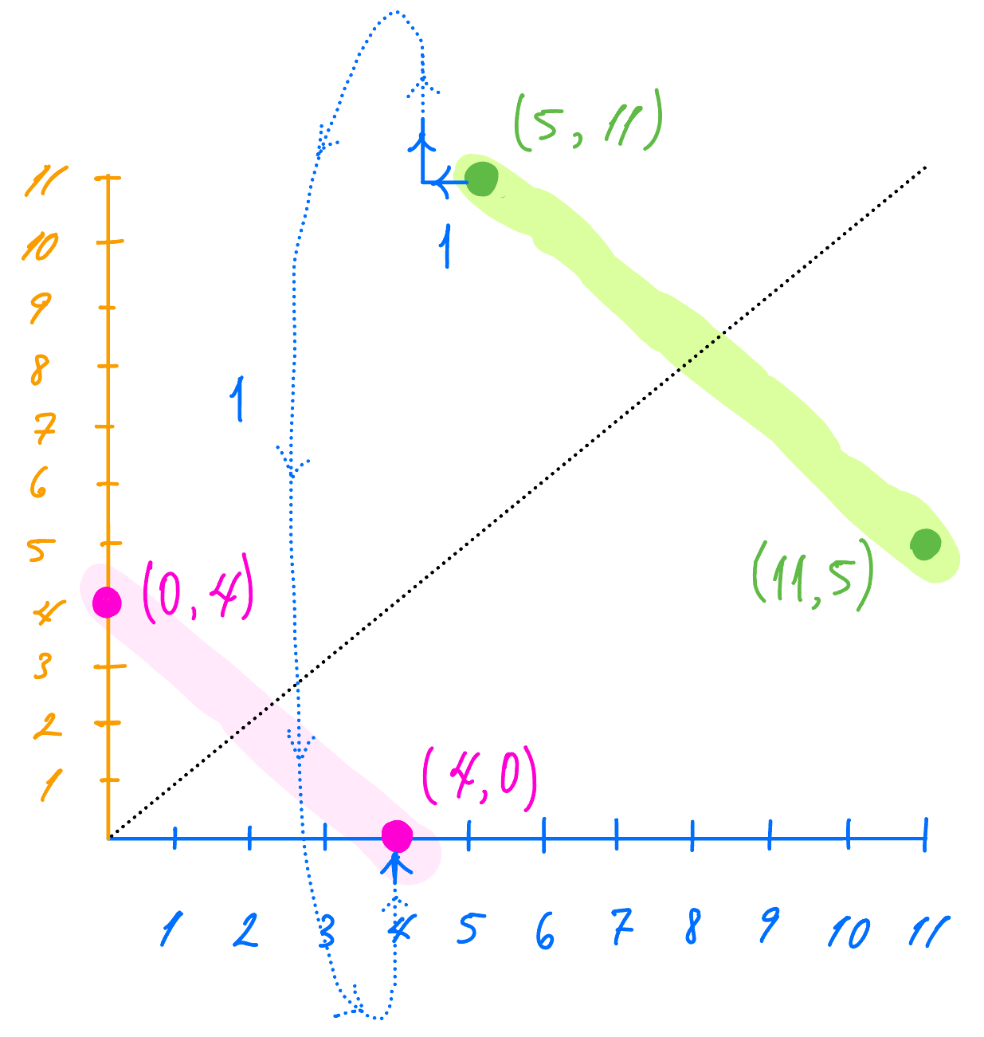
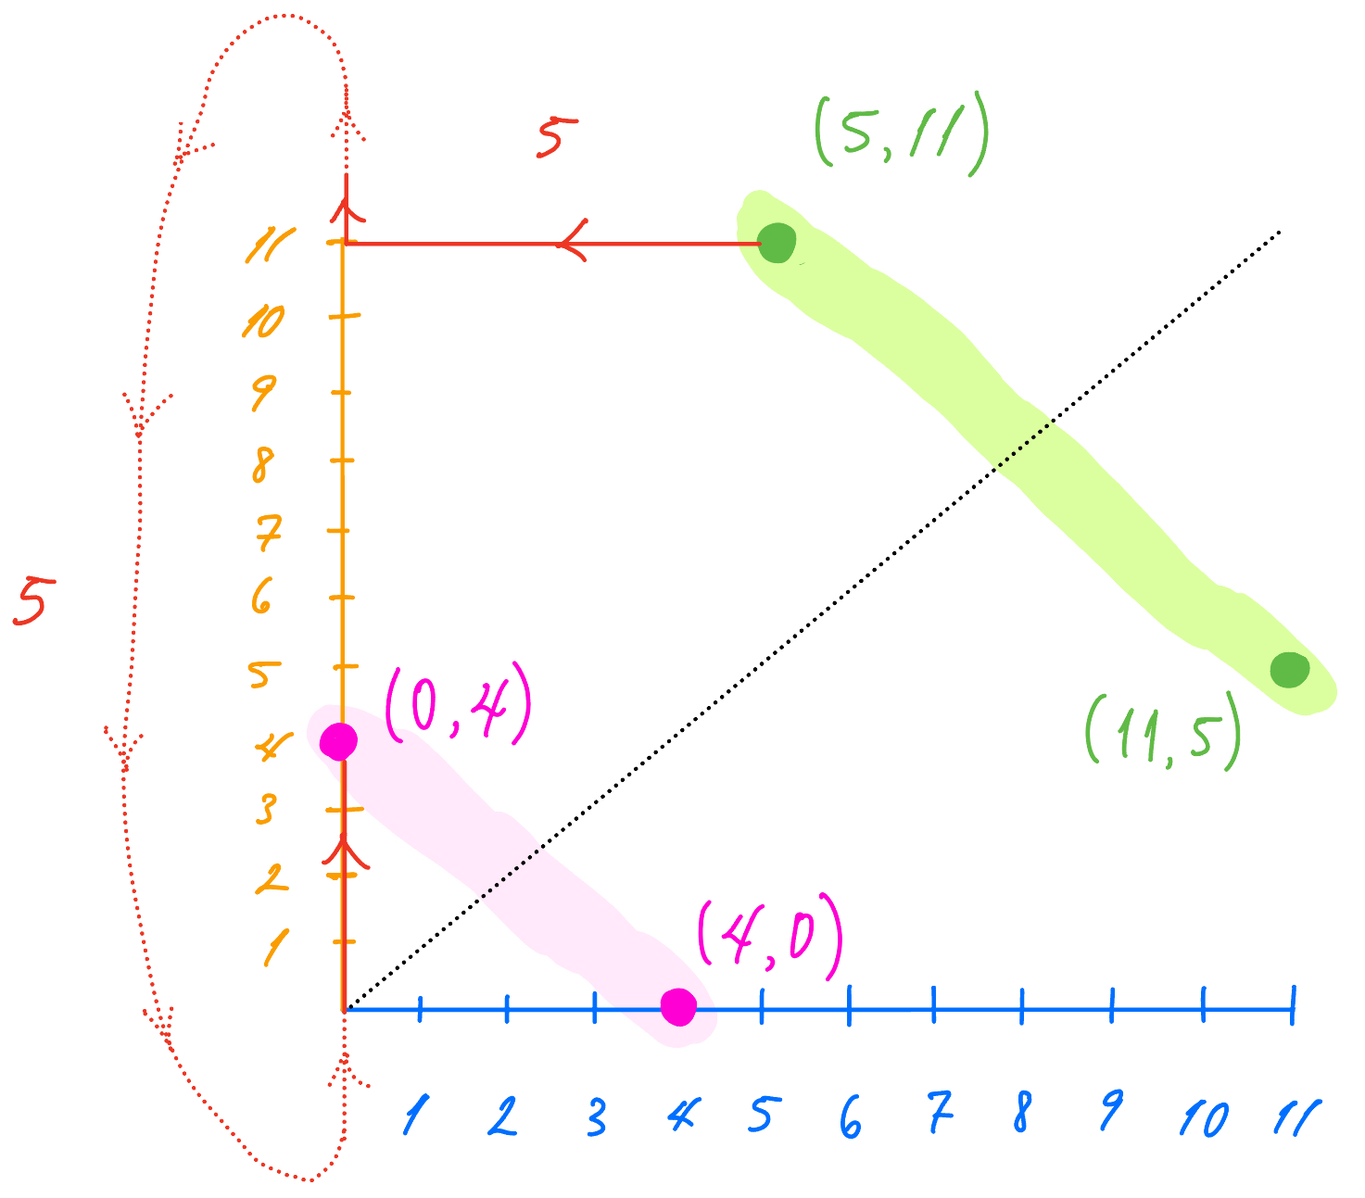
Pleasant Voice Leading is Geodesic Motion III
The geometric space on which we play
Notes:
Alpha & beta illustrated ~ remind audience of identification of (x, y) with (y, x) (and 0 with 12): these identifications cause the space in which we play to become a Möbius strip (not a torus! A torus results if we do not identify (x, y) with (y, x).)

Slide 9
Be a mathemusician!
Hopefully, you’re inspired to learn to play an instrument of your own
(What’s your favorite?)
and
We’re all thoroughly convinced:
Mathematics & music are intrinsically intertwined.

Slide 10
References
Dmitri Tymoczko, The Geometry of Musical Chords. Science 313, 72-74 (2006). DOI: 10.1126/science.1126287

